Slide 1
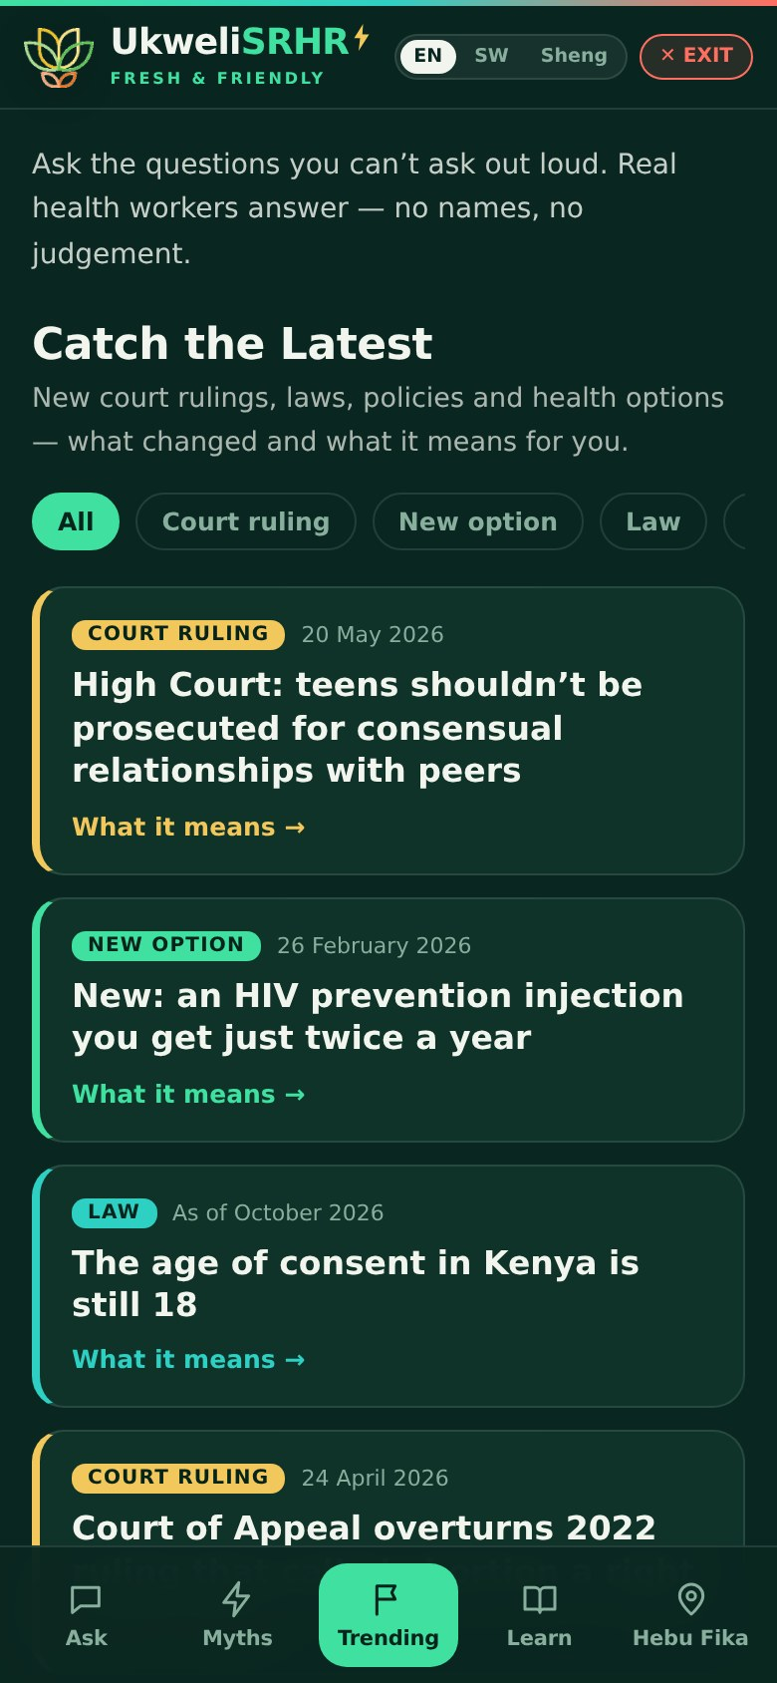

UkweliSRHR — what’s new
Changes made after the youth test run · 2–5 October 2026
ImaarishaSRHR · Community Media Trust
Notes:
This deck summarises the UkweliSRHR build that responded to the youth test-run feedback. Every one of the 16 feedback points was acted on.

Slide 2



Every point young people raised was acted on
16
11
120 → 14
9
feedback points acted on
“Catch the Latest” updates in English and Kiswahili
Trending entries reviewed; genuine claims kept
facilities young people named, added to verify
The three changes that matter most
Young people can get their answers back with a private code
They choose whether an answer is shared or kept private
The app never silently fails or loses their work

Slide 3






What young people told us
Saw someone else’s story
Couldn’t get answers back
Slow, or didn’t send
Public answers were unlabelled under the form
“Check back later” — but how, and where?
Too many steps; failures were silent
Generic, “AI” answers
Language
More clinics, and costs
Grammar and relevance issues
English & Kiswahili core; Sheng needs work
Juja Road, Mathare, Dandora, MSF
Notes:
Also raised: voice and photo questions, a Mental Health & SRHR topic, and that the app looked generic. Myths, Trending and Learn were well liked.

Slide 4
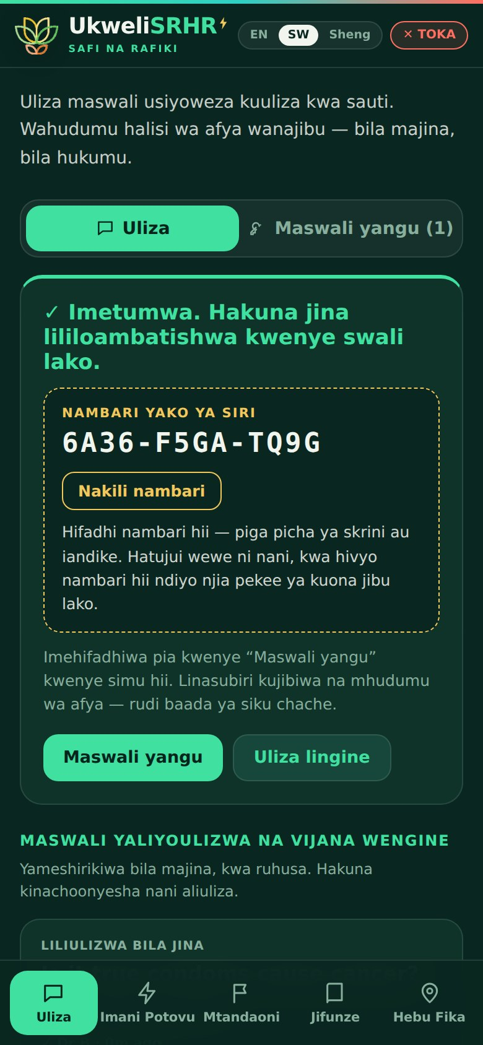
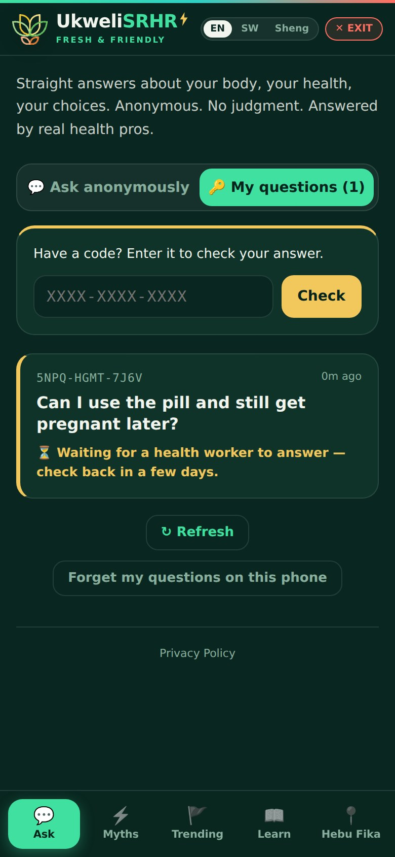
Private by design — and answers come back
Clear labelling
Other people’s questions are headed “Questions other young people asked”, each marked “Asked anonymously”.
Askers choose
Share the answer anonymously to help others, or keep it just for themselves.
A private code
Every question gets a code like 6A36-F5GA-TQ9G. Only a scrambled version is stored — no one can link a question to a person.
“My questions”
Enter the code on any phone to read the answer. Shared phones: codes can be forgotten, and Exit clears drafts.

Slide 5
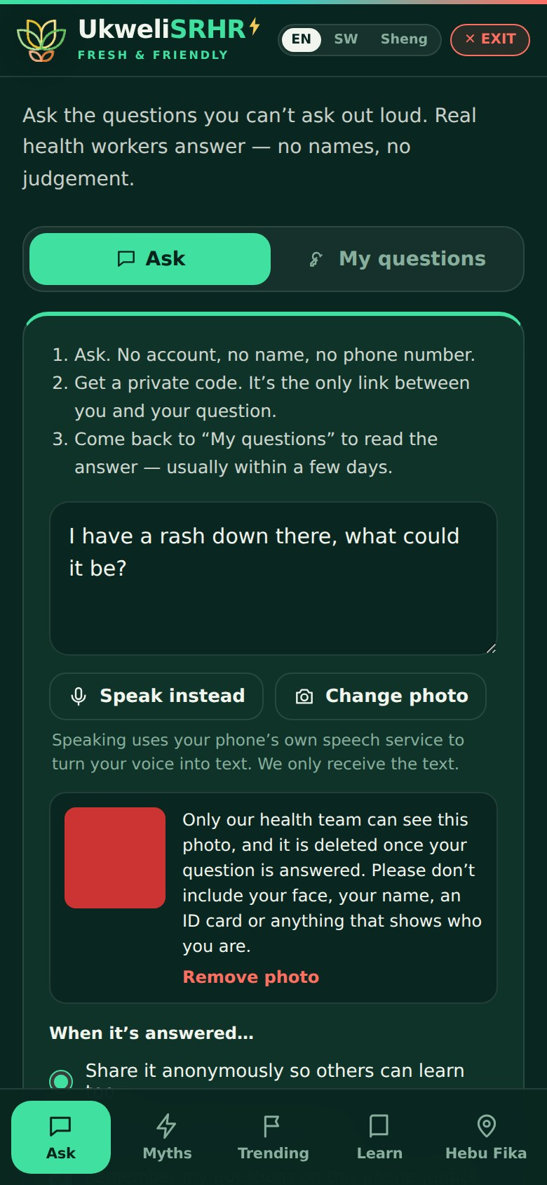




Asking is quicker and clearer
Always responds
The button reacts every time; the security check runs invisibly.
Clear outcomes
Every send ends in the code or a plain error — the question is kept.
Speak instead
Talk instead of typing on supported phones; we only receive the text.
Photo questions
Hidden data removed on the phone; only the health team sees it; deleted once answered.

Slide 6


Nobody loses their place or their work
In UkweliSRHR
In Admin
The open tab and item (a myth, a Learn topic, a county) are kept in the page link
Coming back or reloading returns you to the same spot
Half-written questions survive leaving, but are wiped on Exit or closing the tab
The desk and editor you had open are remembered
Every half-written answer is saved until you publish or sign out
A loading hiccup can’t wipe drafts; “Restore my own draft” after an AI draft

Slide 7
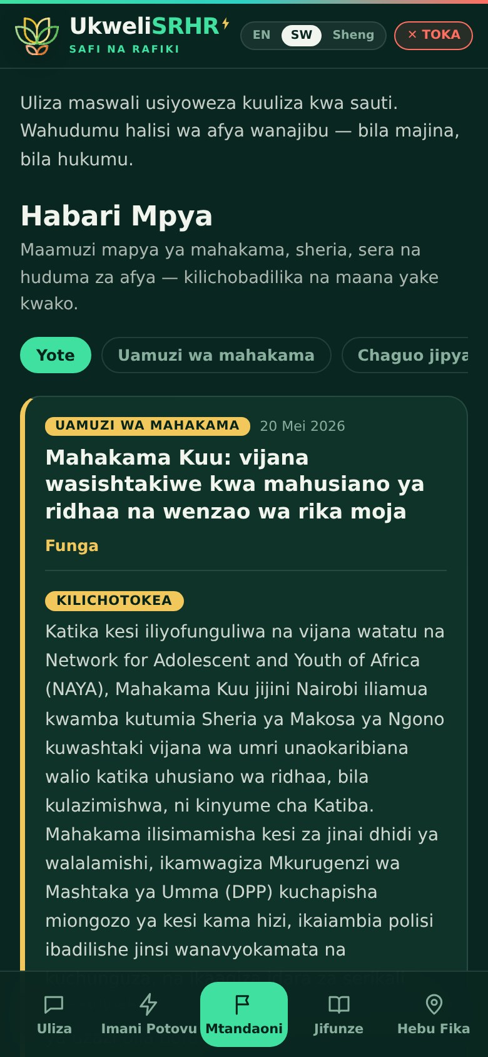
New: Catch the Latest
Court rulings, laws, policies and new health options — what happened, what it means for you, where it stands now, with helplines and sources.
May 2026
High Court: teens in consensual, close-in-age relationships shouldn’t be prosecuted — age of consent still 18
Apr 2026
Court of Appeal overturns 2022 ruling that called abortion a right (now at the Supreme Court)
Feb 2026
Twice-yearly HIV prevention injection (lenacapavir) rolled out
+ 8 more
HPV single dose · GBV & femicide report · school re-entry · Children Act · LGBTQ law status · and more
All 11 in English and Kiswahili · team adds more from Admin with an AI helper

Slide 8
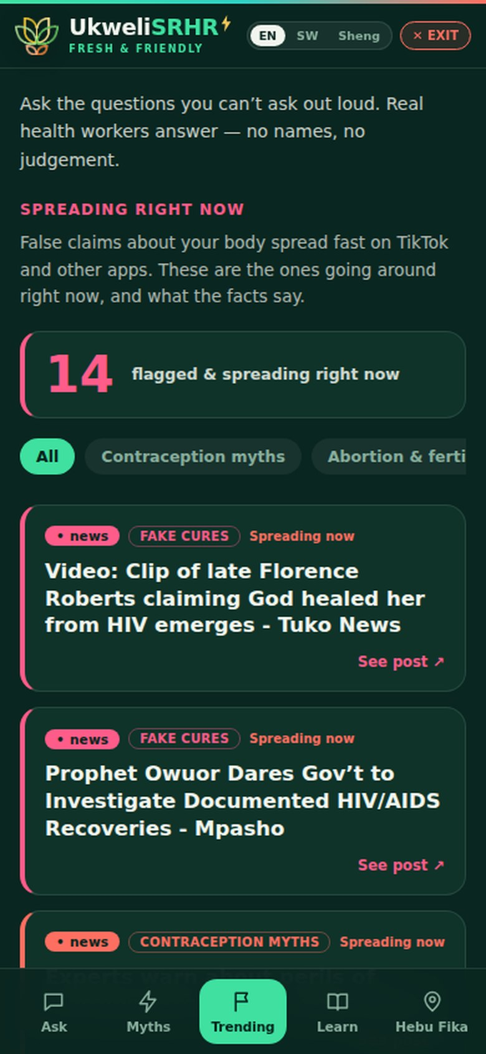
Trending: cleaned up and reviewed
18
summaries that were just broken web code
~40
repeats of the same story from two outlets
14
genuine, relevant claims now shown
Others were reporting, not misinformation, or from other countries and years ago. The scanner now cleans text, skips repeats and only shows recent, Kenya-relevant misinformation. The hub’s Radar keeps everything; the team can show or hide any item.

Slide 9
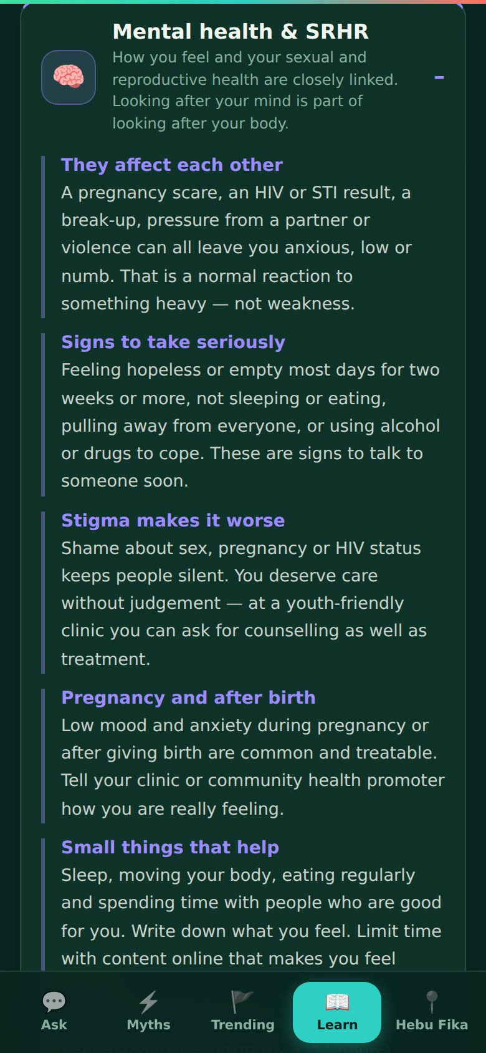
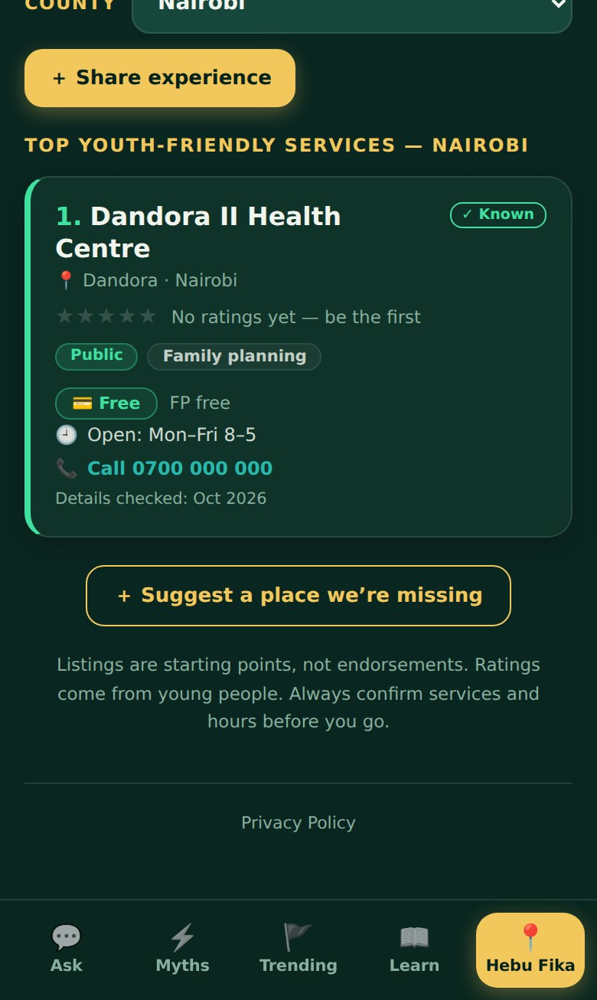
Mental health, and clinics with costs
Mental Health & SRHR
Hebu Fika
A new Learn topic in English and Kiswahili: how feelings and SRH affect each other, signs to take seriously, stigma, pregnancy, and where to talk now (1199, Befrienders, 1190).
Cost shown up front — or “ask before you go”
Hours, ages, tap-to-call, “details checked” date
9 places the young people named (Dandora Youth Centre, MSF Lavender House on Juja Road, Mathare North…) added as drafts to verify

Slide 10
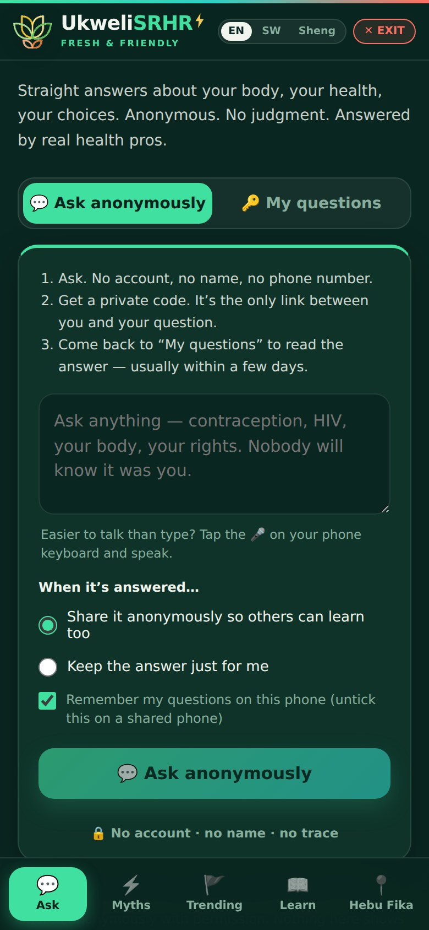
Less “AI-generated”, more human
Calmer design
Line icons instead of emoji, one accent colour, no glowing gradients
Plainer words
“Ask the questions you can’t ask out loud. Real health workers answer — no names, no judgement.”
Languages
English and Kiswahili core; Sheng optional. Leftover English-only text translated
Real Sheng
AI drafts in Sheng are now written in Sheng, ready for a young person to check
Before
After

Slide 11







New tools for the team
Email on every question
AI drafting fixed
Pop-up messages
Review published answers
With language, privacy and photo flags, and a link to the desk
Clearer answers to the exact question; errors now explained
The admin app shows successes and errors at last
Fix wording in place or send back to the queue
Latest desk
Trending show / hide
Facilities editor
Private photos
Add, pin, translate updates; AI drafts from a pasted article
Decide which scanned items young people see
Cost, hours, phone, ages, checked date
Visible to admins only; deleted on answering

Slide 12





What still needs people
Sheng review
Young native speakers read the Sheng wording and any AI-drafted Sheng before publishing
Verify facilities
Phone each of the 9 draft listings; confirm services, cost and hours; then show them
Check the latest
Has the State appealed the May 2026 teen ruling? Lenacapavir cost and minimum age?
Review answers
Work through published answers for relevance, grammar and tone
Watch photos
Keep an eye on photo storage for misuse (3 MB cap per file)
Notes:
Technical record — database updates (in order): 20261002120000_ukweli_youth_feedback, 20261002130000_ukweli_photos_facilities, 20261002140000_ukweli_latest, 20261002160000_trending_review (run once). Server functions: turnstile-verify, activity-notify, uliza-draft, radar-scanner. Commits: 6d7ac75, 450f502, 8393aea, 97994b8, 98444c0, 7b07da1, 383e723, 0049689.

